Slide 1
Business Process Modeling
David Bergman
OPIM 5272

Slide 2
Outline
What is a business process?
Why do we care about business processes?
Success stories
Business process modeling basics

Slide 3
What is a Business Process?
A collection of related, structured activities--a chain of events--that produce a specific service or product for a particular customer or customers.
The complete response that a business makes to an event. A business process entails the execution of a sequence of one or more process steps. It has a clearly defined deliverable or outcome. ...
A business process is a recipe for achieving a commercial result. Each business process has inputs, method and outputs. The inputs are a pre-requisite that must be in place before the method can be put into practice. When the method is applied to the inputs then certain outputs will be created.
A collection of interrelated tasks, initiated in response to an event, achieving a specific result for the customer and other stakeholders.

Slide 4
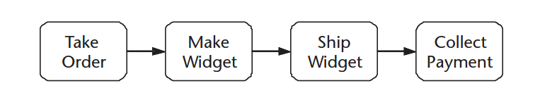
Business Process
A collection of interrelated tasks, initiated in response to an event, achieving a specific result for the customer and other stakeholders.
Events →Tasks → Results
Events
Take Order
Make Widget
Ship Widget
Collect Payment
Business Process
Fulfill Order

Slide 5
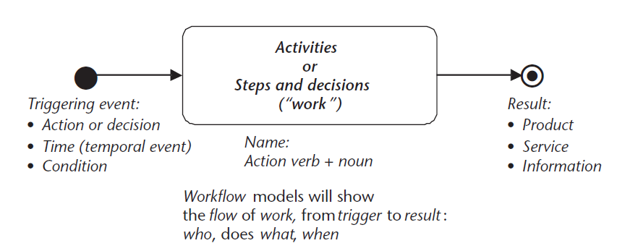
Process

Slide 6
A process…
Is outcome oriented
Product development, order fulfillment
Is for a customer and has stakeholders
Has a trigger event
Is a collection of interrelated tasks
Is not a function
Functions are vertical…processes are horizontal
Functions → Finance, engineering, manufacturing
Process → Fulfill Order

Slide 7
Renew Lease
“Renew Lease” for a real estate company is a business process
Is it a business process?
A collection of interrelated tasks, initiated in response to an event, achieving a specific result for the customer and other stakeholders.
INTERRELATED TASKS
Create lease renewal
Mail lease renewal
Process updated lease amount
TRIGGERING EVENT
90 days until lease expires (leases are for one or two years)
SPECIFIC RESULT (Must be discrete and countable)
Lease is renewed (this should work – flip words in the name of the process!)
CUSTOMER
Tenant
STAKEHOLDERS
Real Estate Company
Employees of the company

Slide 8
Fulfill Takeout Order
“Fulfill Takeout Order” for a pizzeria is a business process
Is it a business process?
A collection of interrelated tasks, initiated in response to an event, achieving a specific result for the customer and other stakeholders.
INTERRELATED TASKS
Place order
Take order
Collect payment
Etc.
TRIGGERING EVENT
Person in community gets hungry
SPECIFIC RESULT (Must be discrete and countable)
Takeout order is fulfilled
CUSTOMER
Restaurant patron
STAKEHOLDERS
Pizzeria
Community

Slide 9
Procure Stone Slabs
“Procure stone slabs” for a Granite processing company is a business process
Is it a business process?
A collection of interrelated tasks, initiated in response to an event, achieving a specific result for the customer and other stakeholders.
INTERRELATED TASKS
Place order
Receive invoice
Deliver payment
Verify receipt
TRIGGERING EVENT
Inventory is depleted
SPECIFIC RESULT (Must be discrete and countable)
Stone slab is procured
CUSTOMER
Granite company
Home Depot
Supplier of material
Costco
STAKEHOLDERS
Company
Community

Slide 10
What is NOT a business process
At a University
Energize University’s distinctive educational experience
Enhance University's recognition
Etc.
At a manufacturing company
Enhance customer service
Optimize floor layout
What would be a Business Process for a University?

Slide 11
Components of a Business Process
A collection of interrelated tasks, initiated in response to an event, achieving a specific result for the customer and other stakeholders.
Interrelated tasks
Initiated by an event
Achieving a result
For the customer and stakeholders

Slide 12
Tasks/Activities
Small step in an overall process
Can be accomplished by one individual, or a simple activity done by a computer/machine
Calculate credit → part of Acquire New Customer process
Set customer account type → part of Acquire New Customer process
Submit application package → part of Apply For Job process
Submit permit application → part of Grant Building Permit process
Activate customer account → part of Move Telephone Service process

Slide 13
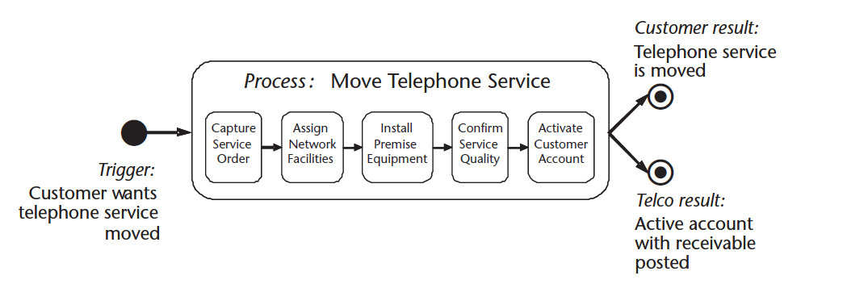
A process involves several interrelated tasks

Slide 14
Initiated by Events (Trigger)
Starts a process
Action Event
Person/organization decides to do something
Customer places order
Manager decides a new employee is needed
Regulator issues a new guideline
Temporal Event
Predetermined time occurs – typically cyclic
Monthly subscription release date
Biweekly payroll date
Take inventory date
Can predict when these will occur
Condition or Rule Event
Monitoring activity detects something
Smoke alarm
Stock prices
Can’t predict when these occur

Slide 15
Achieving a Specific Result
Results
Discrete and identifiable
Can talk about one of them
Customer is acquired
Job application completed
Telephone service moved
Countable
You can count how many have been processed in a day, week, month, etc.
Essential
Fundamentally necessary for the operation of the enterprise
Must focus on “what”, not how of who
Not an objective
An objective is some desired state or performance target
“Fewer than 10% of newly hired employees will leave the company
A process must have a specific result, that can be talked about on a individual case basis
Even “decrease number of newly hired employees that will leave the company”

Slide 16
Customer/Stakeholder
External Customer
Core processes
The reason why the enterprise exists
Activate telephone service
Move telephone service
Internal Customer
Supporting processes for the enterprise
Can be HR-oriented
Assess Employee Performance
Provide Employee Benefits
Build facility
Or even Modify a Business Process!
Stakeholder
Any identifiable individual or group who is impacted by the business process
Customer – receives result
Performer – performs a step
Regulator/Environment – interests that must be protected

Slide 17
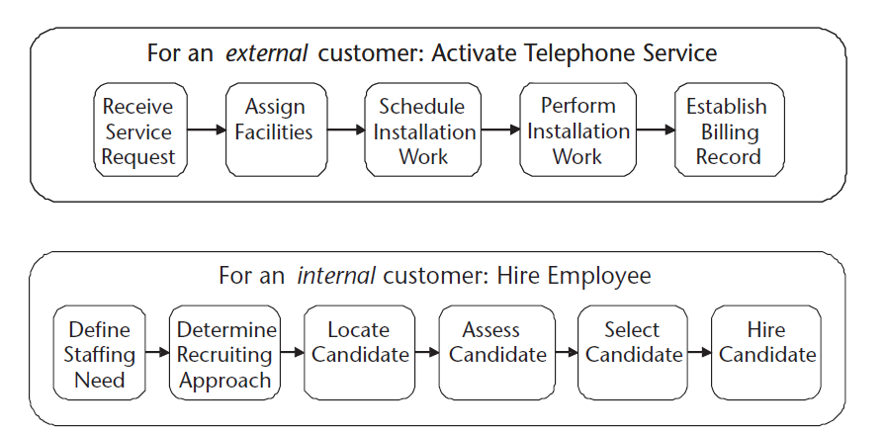
Example: External/Internal

Slide 18
Components of a Business Process
A collection of interrelated tasks, initiated in response to an event, achieving a specific result for the customer and other stakeholders.
Interrelated tasks
Initiated by an event
Achieving a result
For the customer and stakeholders

Slide 19
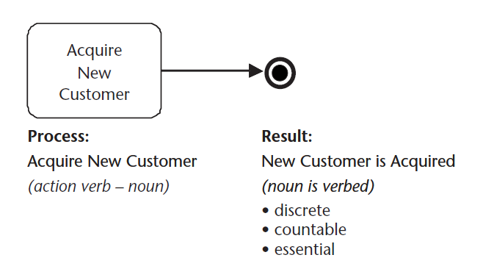
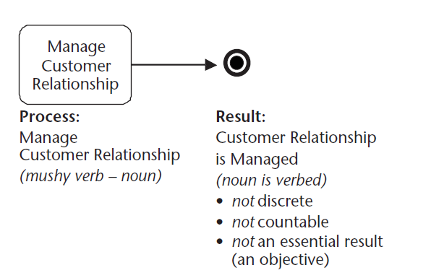
Difference?
A collection of interrelated tasks, initiated in response to an event, achieving a specific result for the customer and other stakeholders.

Slide 20
What is a Process?
Suggested Process | What you might call it | Why?
Customer Relationship Management | Process Area | Doesn’t deliver a single, specific result; it is a set of related business process, meeting an overall objective
Acquire New Customer | Business Process | Delivers a single, specific result. An “end-to-end” business process
Assess Client Financial Status | Subprocess or Activity | Too small – it is a part of the process “assign credit line”
Set Up Customer Account | Activity | Much too small
Determine Credit Limit | Activity | Again, too small
Oracle Database | System | Not a discrete, countable outcome
Sales Department | Department | Has many processes

Slide 21
Team Exercise
Think about the University of Connecticut – can you identify some key processes?
Think about an organization you’ve worked for – can you identify some key processes?

Slide 22
Process Reengineering
Radical redesign of broad, cross-functional business processes with the objective of order-of-magnitude performance gains, often with the aid of information technology
Reengineering the Corporation: A Manifesto for Business Revolution, Hammer and Champy, 1993
The goal here is to identify business processes in order to undergo process reengineering which will have order-of-magnitude performance gains
Identify Business Process
Model Existing Process (As-Is)
Identify Issues
Reengineer Process (To-Be)

Slide 23
Traditional Functional Organization
Strategic level
Senior managers
Management level
Middle managers
Knowledge and
Knowledge level
data workers
Operational
Operational level
managers
Sales
Manufac
Finance
etc.
HR
turing

Slide 24
What is a Business Process Model?
Documentation of a business process using a combination of text and graphical notation.
Depicts the Process
Shows how an organization provides value to their customer with a strong emphasis on the sequence of work.
Defines a process as a specific ordering of work activities
Across time
Beginning, an end, and clearly defined inputs and outputs.

Slide 25
Business Process Modeling
Business process modeling (BPM) is the activity of representing processes of an enterprise, so that the current process may be analyzed and improved
There are many different ways to represent processes
We will concentrate on swim-lane diagrams
Map of how a unit of the process moves from actor to actor

Slide 26
Outline
What is a business process?
Why do we care about business processes?
Success stories
Business process modeling basics

Slide 27
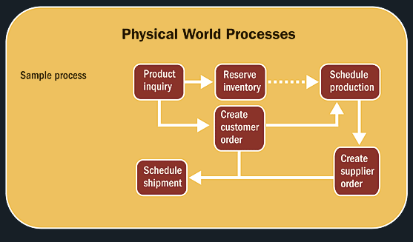
Why is Process Analysis important?
The IT – Business bridge

Slide 28
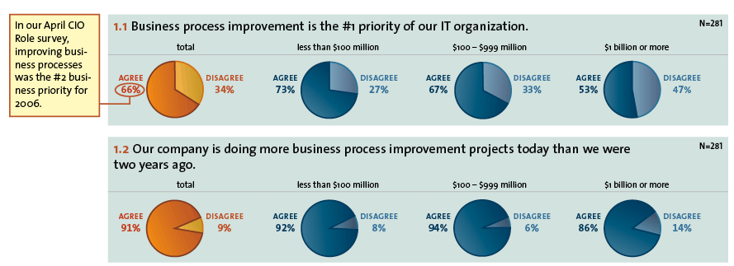
CIOInsight.com research - 2007

Slide 29
Process Reengineering Should be Broad!
Depth Levers
Roles and Responsibilities
Measurement and Incentives
Organizational Structure
Information Technology
Shared Values
Skills
Changing one would be UniDimensional – Changing several would be MultiDimensional
Breadth
Entire business unit versus single function

Slide 30
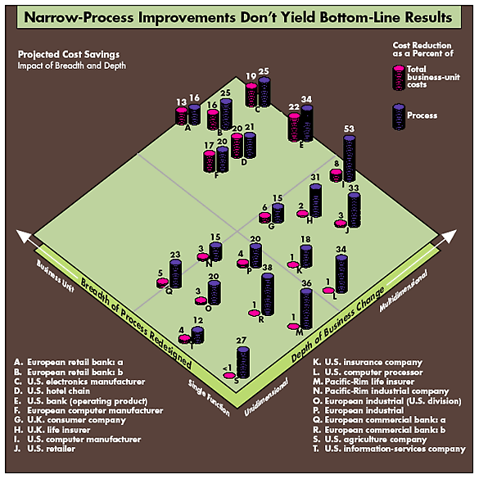

Slide 31
LEVERS
Roles and Responsibilities
Measurement and Incentives
Organizational Structure
Information Technology
Shared Values
Skills
Multidimensional
Unidimensional
Depth reduces specific process costs
(Source: Hall, Rosenthal, Wade, HBR, 1993).

Slide 32
Business Unit
Single Activity/Function
Breadth reduces overall business unit costs
(Source: Hall, Rosenthal, Wade, HBR, 1993).

Slide 33
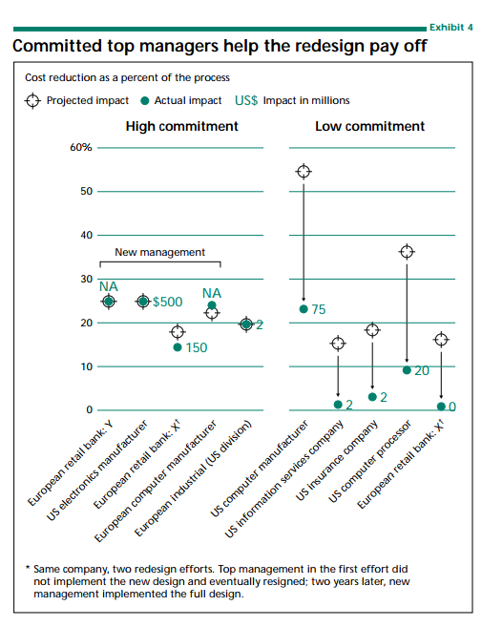
Same company – New Management!
Need devotion FROM management
(Source: Hall, Rosenthal, Wade, HBR, 1993).

Slide 34
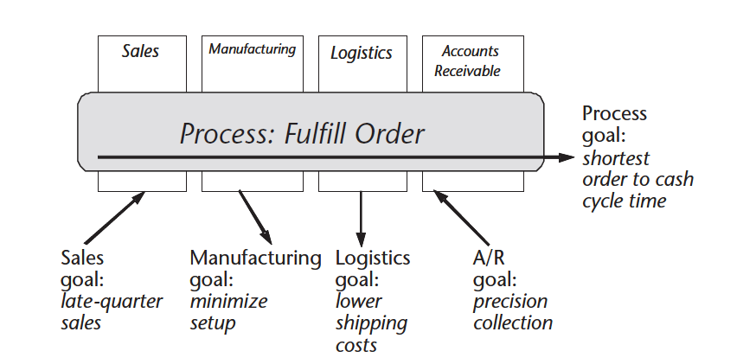
One Key Advantage of Process Modeling
See the entire picture
Local optimization is a big problem
Sales goal: Receive bonus for late quarter sales
Manufacturing goal: machine utilization
Logistics goal: lowest unit costs for shipping
A/R goal: precision collection

Slide 35
Other Key Advantages of Process Modeling
Value-added vs. non-value added activities
When checks are routine and frequent they lose meaning
Handoffs become transparent
How does an application for a building permit get routed?
Who does it get routed to?
Sequential or parallel?
Many more ….

Slide 36
Case manager / Process owner
Any reporting function on process flow is non-value-added
Case manager improves process ownership
Company recognizes importance of process
Before:
Financing
Credit checking
Approval
Issuance
Credit request
Credit decision
After:
Credit request
Credit decision
Case manager

Slide 37
Making it work – Process Owners
Advocate process management through process owners
Process owners manage and ensure intersection of process and functional unit goals
Make functional goals process goals
Budgets by process
Process budgets aggregate to functional unit budgets
Often a senior or top level manager
Cross-functional process performance
Designs, Monitors and Reports
Manage the interface between functional departments
Sometimes, process teams may assist the process owner

Slide 38
Outline
What is a business process?
Why do we care about business processes?
Success stories
Business process modeling basics

Slide 39
Three BPR Success Stories
1: CVS
2: PBX sales at AT&T
3: Ford Accounts Payable

Slide 40
CVS: Pharmacy Service Initiative
ABOUT CVS
CVS ( Consumer Value Store) first opened in Lowell, Massachusetts in 1963
Currently, it has more than 4000 outlets with a revenue of $24.2 billion
Pharmacy accounts for two- thirds of the overall revenue
WHY PSI?
Customer Service Problems
Pharmacy Operations Underperforming
Why? What was wrong?

Slide 41
CVS
INTERVIEWS AND ANALYSIS
Analysis of Historical Data
Interviews of Current and Former Customers
Interviews of Customers of Other Pharmacies
FIELDWORK
PSI members spent time across CVS pharmacies observing Pharmacy Fulfillment Process
FINDINGS
CVS had 29.5 million pharmacy members with a revenue of $20 billion (2000)
7.2 million regular customers left during the year
8.5 million new regular members added during the year
Loss of $2.5 billion due to Customer Defections
Approx. 25% prescriptions faced problems during fulfillment process
16% prescriptions had unresolved problems at customer pickup
40% Customers voiced Complaint

Slide 42
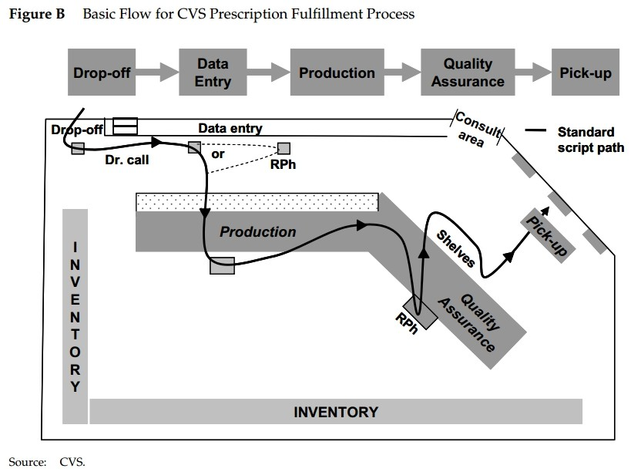
Prescription Fulfillment Process

Slide 43
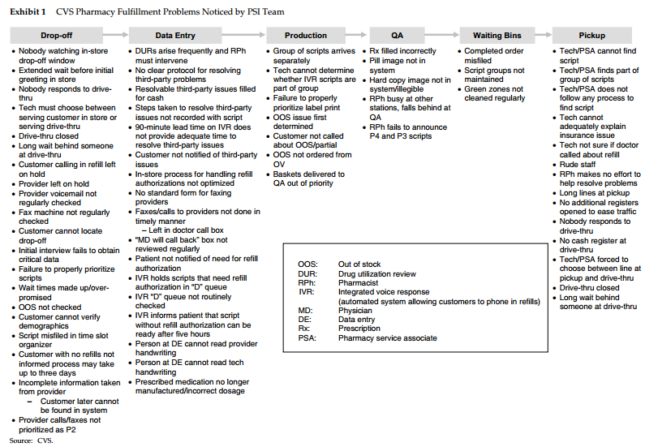
Issues!

Slide 44
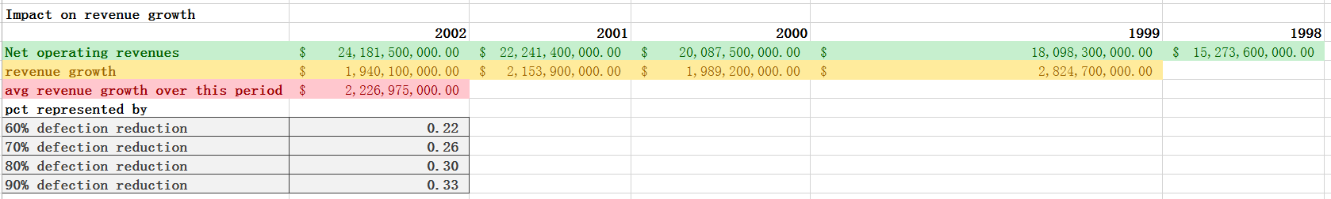
What could happen?
Assuming a 90% defection reduction, there is a 33% improvement in revenue.

Slide 45
PBX sales at AT&T
$4B annual sales of PBX equipment in US
By 1989, frustration sank in
Each year the business had met higher performance targets for individual functions, but overall profit did not increase.
The president decided to redesign the business’s core processes.
He appointed a top-performing sales branch manager as team leader, plus a full-time team from a wide range of functions: sales, services, product management, Bell Labs, manufacturing, materials management, information systems, and training.
He told them that if they failed, the business would be sold or liquidated.

Slide 46
PBX sales at AT&T: June 1989-Feb 1990
Team took a wide-lens approach
Surveyed steps from initial customer contact (trigger) through to collection of funds (target)
Interviewed employees and customers and constructed 24 cases which they then analyzed in great detail.
They identified every person involved, their activities, and how their time was spent.

Slide 47
PBX sales at AT&T
ISSUES
In all, 16 handoffs were required to install a new system.
Excessive rework
No one had responsibility for the entire transaction.
What if a customer called to make a single change? No one saw the entire project through!
It could take up to a year to get a large system installed, by which time customer needs might have changed → dissatisfaction.
Front-line employees lacked information on profit contribution of their actions. Marketing often concentrated on low-profit customers. Sales concentrated on maximizing revenue, not profit.
Too much use of headquarters staff for various tasks, but little value added.
Sales staff worked for AT&T, not specific to PBX, and their main sales were not PBXs. So sales staff knew little about PBXs, which did not impress customers.

Slide 48
PBX sales at AT&T: Redesign
Appointed Process Owner to build and run a new PBX sales force.
Her goal was to maximize profit and minimize time between sale and installation.
Redesign team proposed a new position, called Project Manager, defined tasks that cut handoffs down from 16 to 3, and estimated that for a typical small system:
the cycle time could be cut from 3 months to 3 weeks,
costs would drop by one third
errors would approach zero.

Slide 49
PBX sales at AT&T
Results
Customer willingness to repurchase: 53% →82%
Bills paid in 30 days from installation: 31%→ 71%
88% of customers rate project management of their sale and installation as “excellent”
Summary
Redesigning the process caused these improvements. The actual PBXs did not change. By changing process, it was possible to produce big increases in value to the customer.

Slide 50
Ford
In the late 1980s, Ford had a traditional purchasing and accounts payable system:
Ford’s Purchasing Department wrote a purchase order for some item
A copy was forwarded to Accounts Payable
Material Control received the item
A copy of the received document sent to Accounts Payable
Vendor sent an invoice to Accounts Payable
Accounts Payable took all three documents (when they were received) and finally was able to issue payment
If everything matched → payment sent
If Not → contact someone?? MOST TIME SPENT HERE

Slide 51
Ford
Clerks in Accounts Payable checked to ensure Purchase Requisitions (from manufacturing), Purchase orders, Receiving reports, Supplier invoices matched: released statements that for each invoice, there was both a purchase order and a receiving report. If OK, they authorized payment.
From an internal control point of view, there were good reasons for this process design.
There were 500 staff members in Ford’s Accounts Payable department
The department was running efficiently.

Slide 52
Ford
In the late 1980’s, Ford bought a 25% stake in Mazda
There were only 5 staff members in Mazda’s Accounts Payable. Yet Mazda was not 100 times smaller.
Why???
Not an accounts payable issue – PROCESS issue

Slide 53
Ford
Process was reengineered
Buyers registers orders online – into a database
When goods arrived, Receiving checked that the goods had been ordered. If accepted, funds were transferred automatically to the supplier.
If No order is seen, send goods back

Slide 54
Ford
Results:
radical: 500 staff dropped to 130
10 million dollars per year!
process: cross-functional
To save money, it would not have worked to have functional thinking
For example, looking just at accounts payable
Needed to have a process eye

Slide 55
Can be simple too
Library – Facilities redesign
Check out lane
Payment lane

Slide 56
Outline
What is a business process?
Why do we care about business processes?
Success stories
Business process modeling basics

Slide 57
Business Process
A collection of interrelated tasks, initiated in response to an event, achieving a specific result for the customer and other stakeholders.
Events →Tasks → Results
Events
Take Order
Make Product
Ship Product
Collect Payment
Business Process
Fulfill Order

Slide 58
As-Is Process Modeling
Builds a model for how a process looks/behaves
What does it look like?
Depends! (we will see shortly)
Why are we doing it?
Restructure or enhance business workflow in order to:
Improve customer service
Cut operational costs (time and money)
Leads to potential competitive advantage

Slide 59
Purpose of As-Is Modeling
Goal: See how workflow impacts process performance
Identify how enablers impede and/or support process and can be made to enhance business process
Workflow design
Information systems
Motivation and Measurement
Human resources
Policies and rules
Facilities (and others)

Slide 60
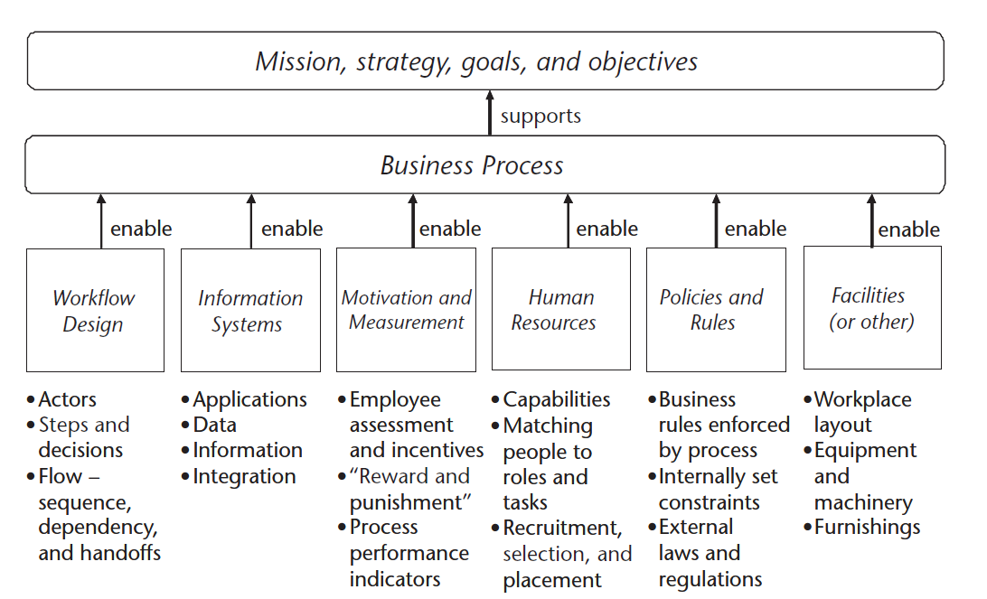
Enablers

Slide 61
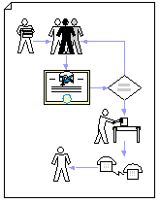
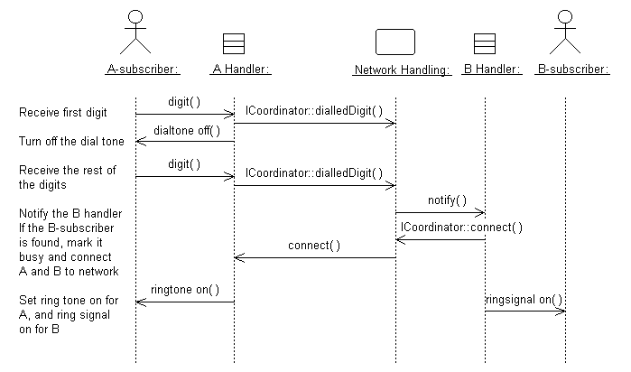
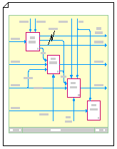
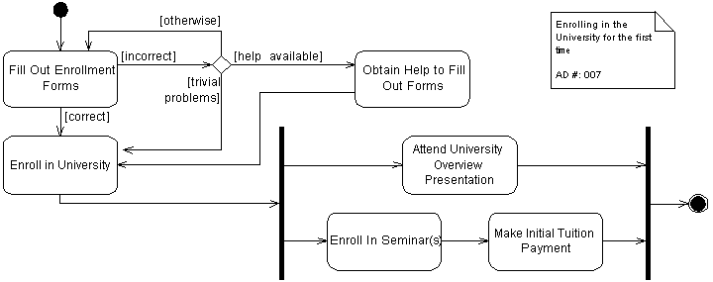
What does a BPM look like?
“It Depends”

Slide 62
What Process Design entails
Understanding business environment and goals
Who interacts with whom?
Why?
In what order?
Questioning explicit and implicit rules and assumptions
All credit decisions are made in credit dept
All purchase orders must be routed through the purchasing department
Expense reports must attach receipts for all items
An order must be reviewed by several managers before proceeding
End Goals
Restructure or enhance business workflow in order to:
Improve customer service
Cut operational costs (time and money)
Specifically to see which enablers are enabling or hurting the process
Leads to potential competitive advantage

Slide 63
As-Is Modeling
We will concentrate on Swimlane Diagrams – model a single unit of process (remember: a process must be discrete or countable!) through the enterprise
Actors
An organization, job, or system with a role in achieving the process’ results
Each has its own swimlane
Flow
A sequential dependency between steps
Handoffs
Flow from one actors swimlane to another
Steps
An activity or task (remember: many tasks make up a process!)

Slide 64
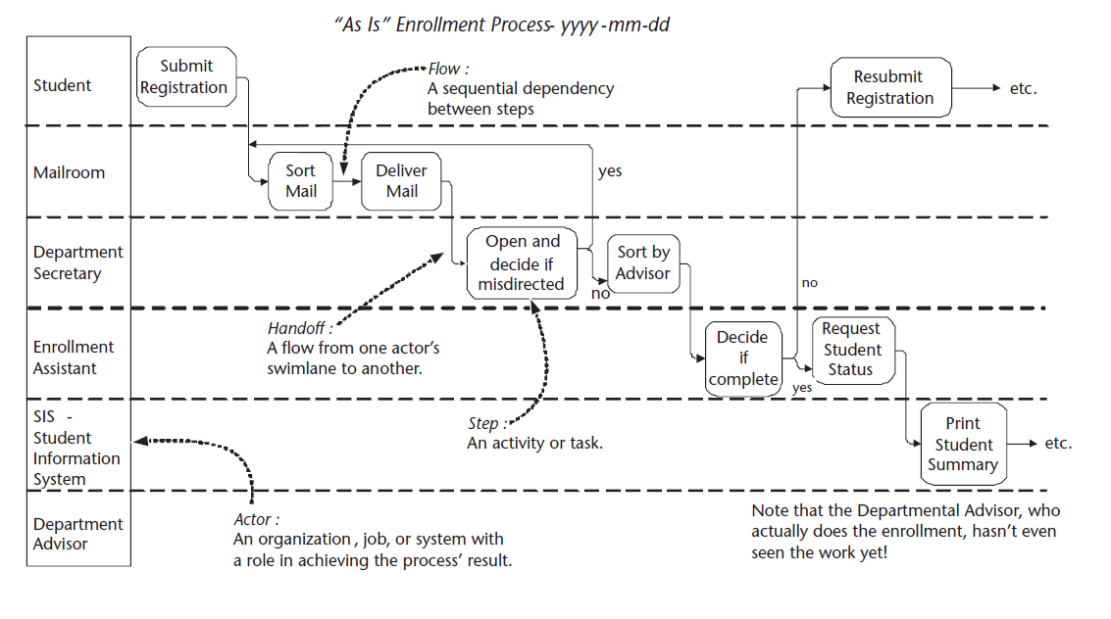
As-Is Modeling

Slide 65
As-Is Modeling
We will concentrate on Swimlane Diagrams – model a single unit of process (remember: a process must be discrete or countable!) through the enterprise
Actors
An organization, job, or system with a role in achieving the process’ results
Each has its own swimlane
Flow
A sequentially dependency between steps
Handoffs
Flow from one actors swimlane to another
Steps
An activity or task (remember: many tasks make up a process!)
Let’s go through each in a bit more detail …

Slide 66
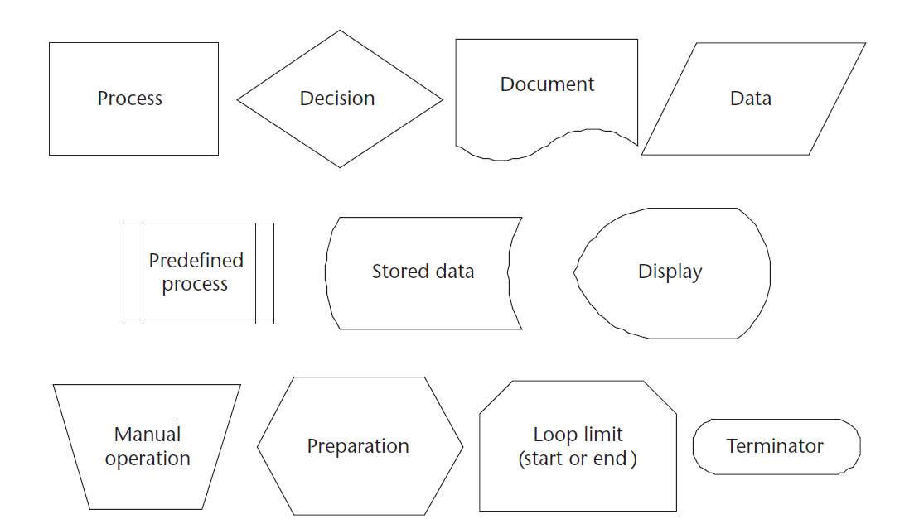
A note on symbols …

Slide 67
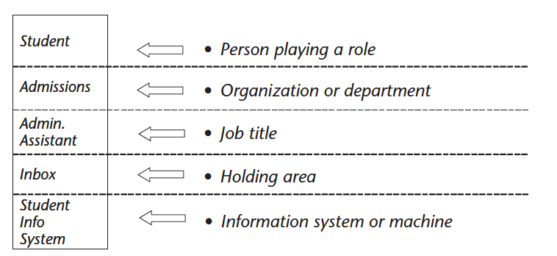
Actors

Slide 68
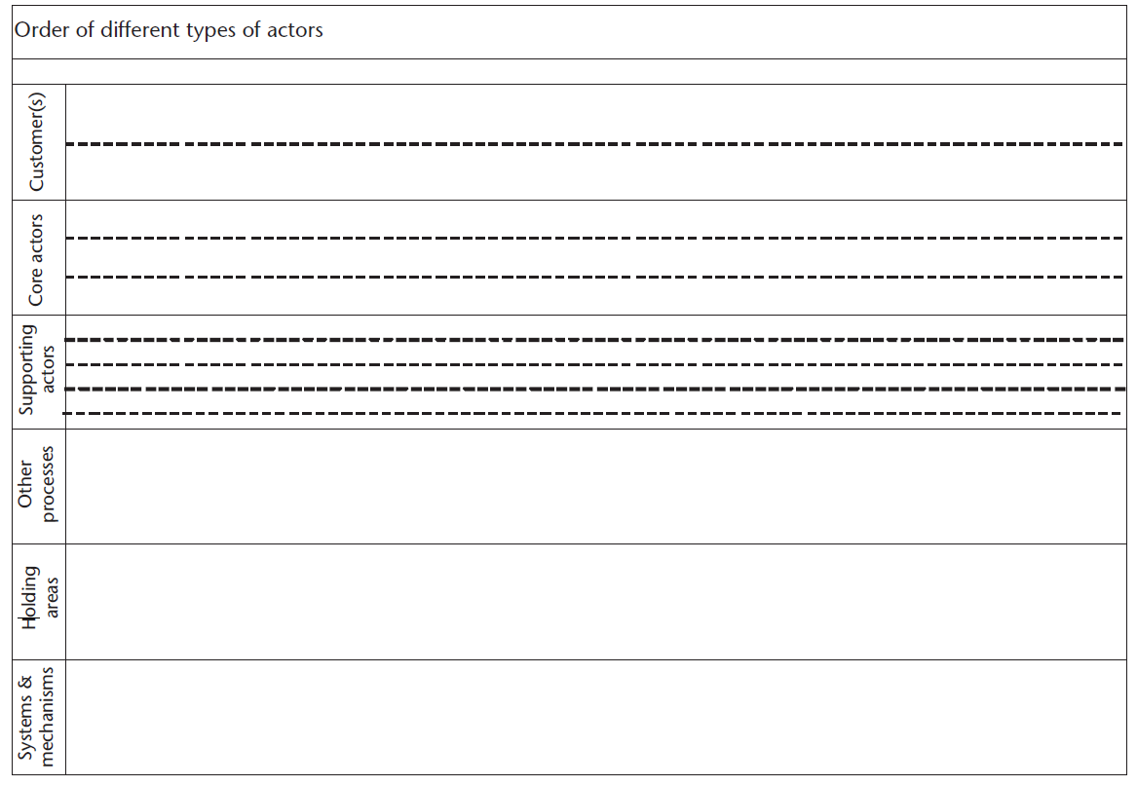
Actors
Order
Customers
Core actors
Supporting actors
Other processes
Holding areas
Systems and mechanisms

Slide 69
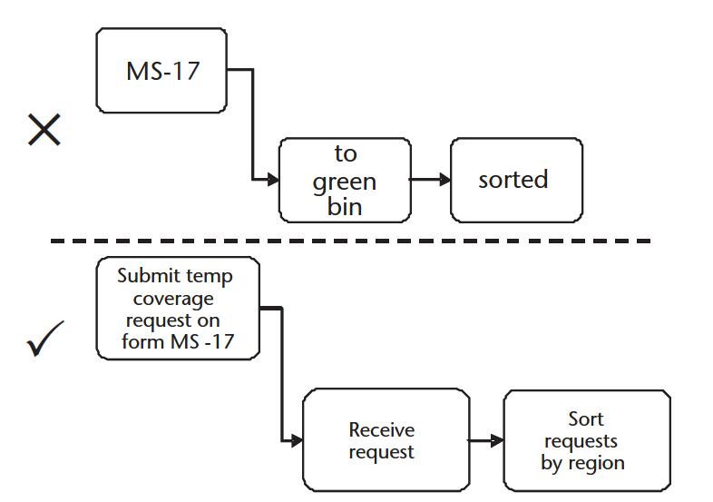
Steps
Some unit of work performed by an actor
Name should be understood by all parties, including “Business People” and external individuals

Slide 70
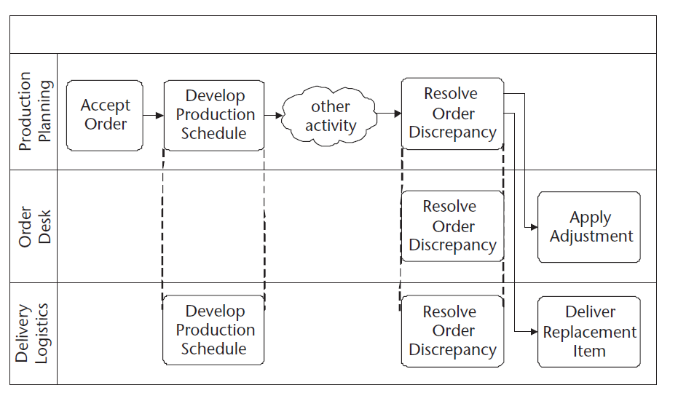
Steps

Slide 71
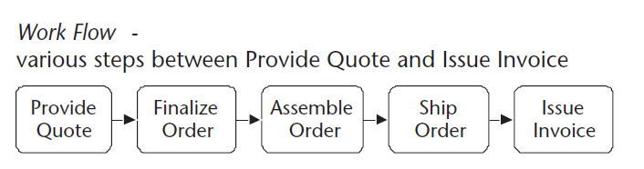
Flows
Passing of work from one step to the next
Flow lines
Leave right edge and enter left edge
From left to right (typically)
Can identify where there are problems

Slide 72
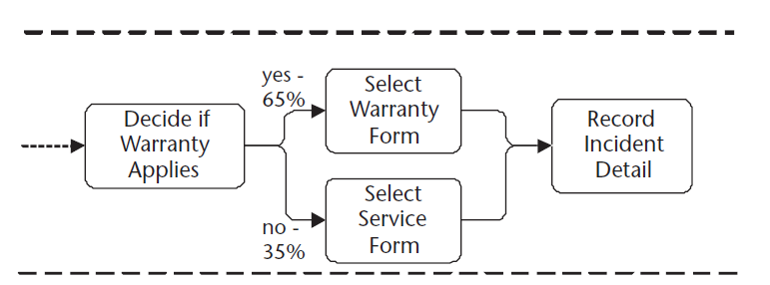
Conditional / Parallel Flows

Slide 73
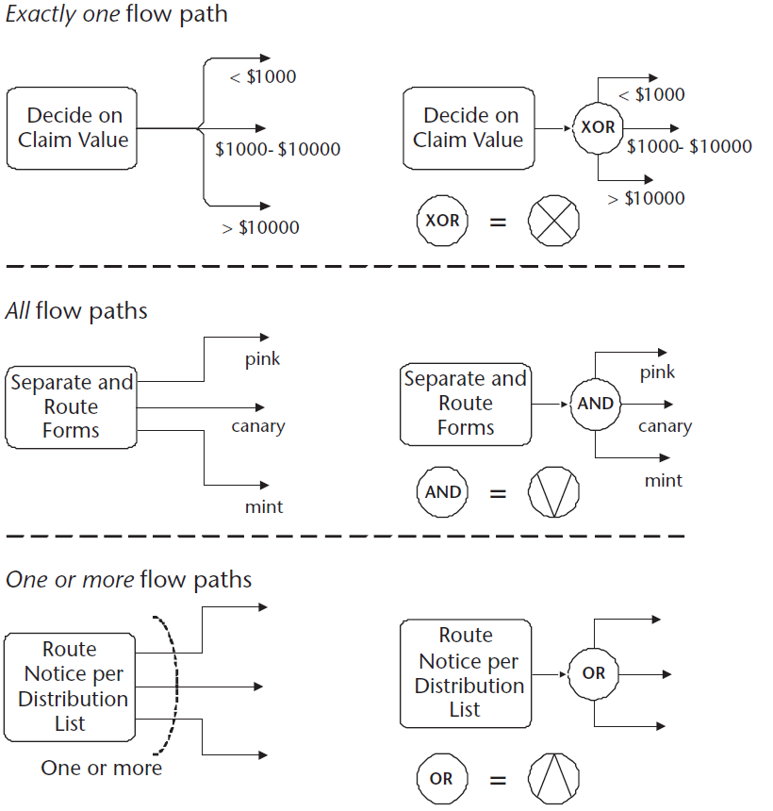
Conditional Flow Outputs

Slide 74
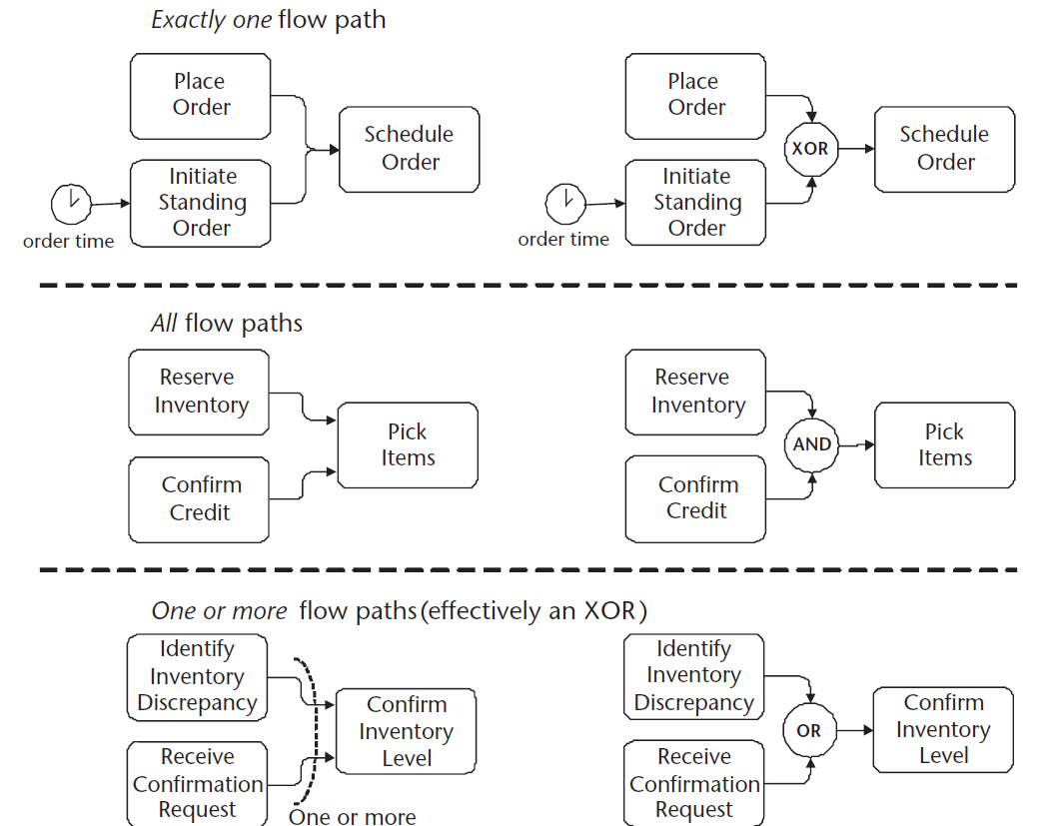
Conditional Flow Inputs

Slide 75
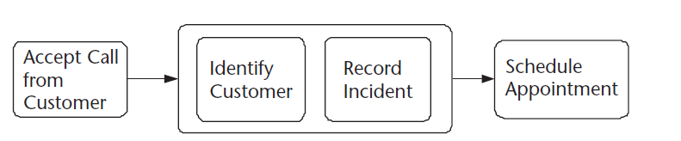
Sometimes flow isn’t sequential .. But only sometimes!

Slide 76
Levels of Specificity
Handoff Level Diagram
Overview of tasks each actor performs, and flow between these tasks
Simplifies steps so that there is no (or very little) non-handoff flow
May already be detailed enough
Who and When
Service Level Diagram
More specificity by adding key steps an actor might perform sequentially
Not always needed – remember, the goal is to identify problems! If they are already identified by Handoff Level Diagrams, stop!
What
Tasks Level Diagram
Describes the details of how the each task is done
How

Slide 77
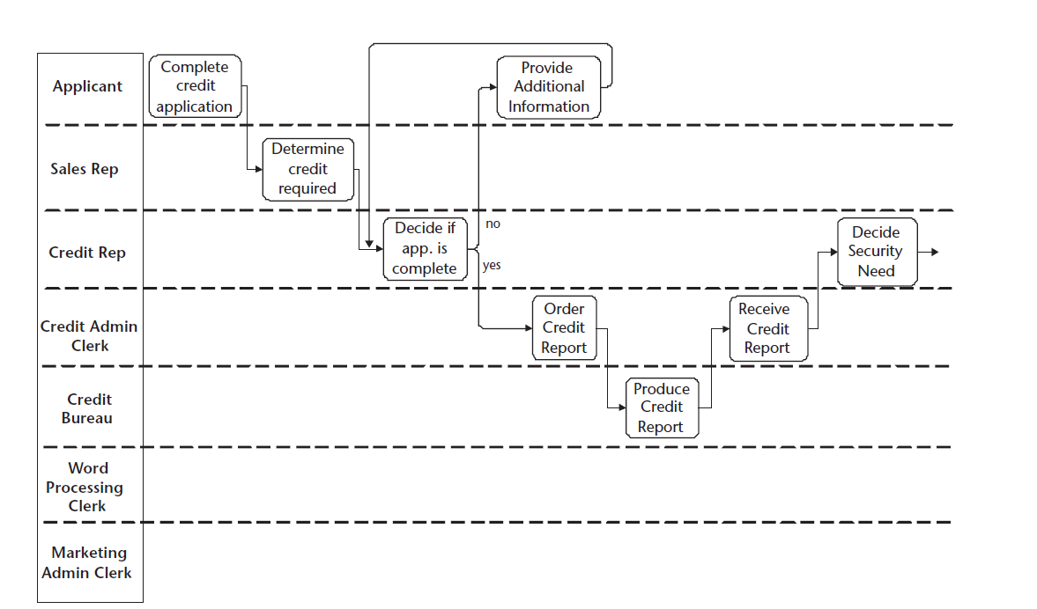
Handoff Diagram - 1

Slide 78
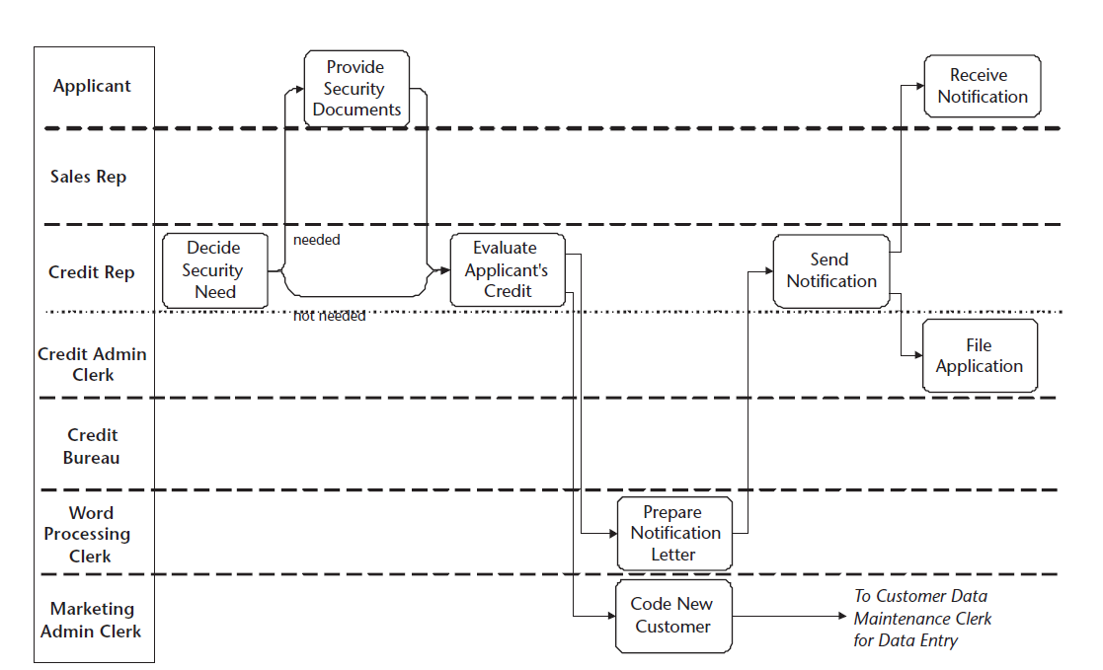
Handoff Diagram - 2

Slide 79
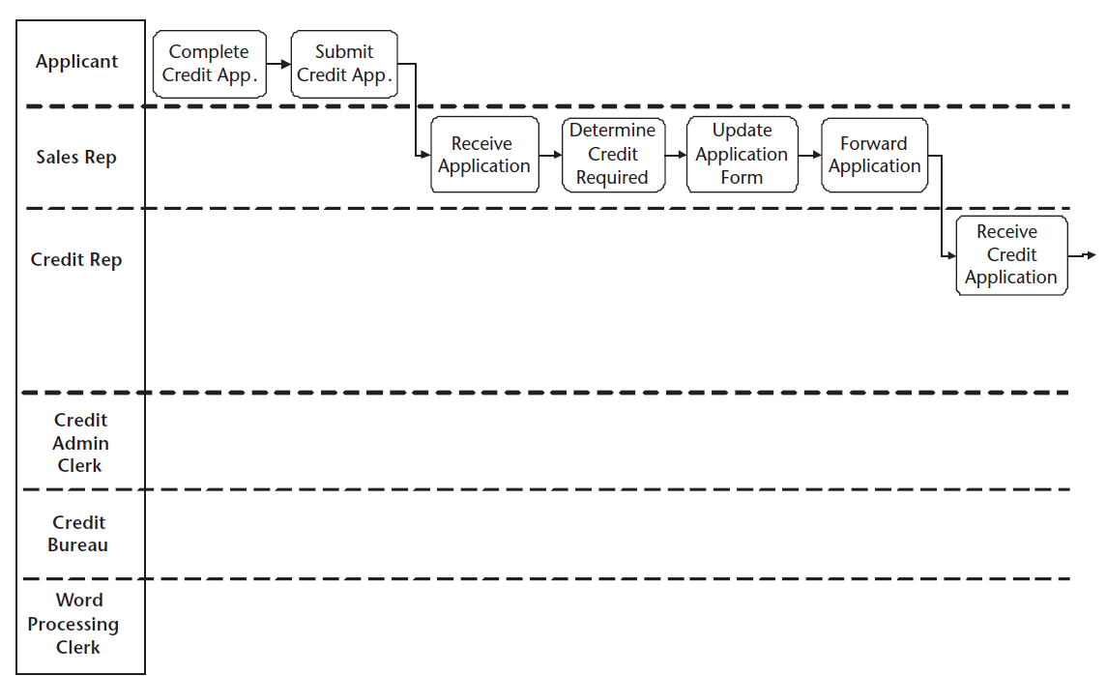
Service Level Diagram - 1

Slide 80
Handoff Diagram - 1

Slide 81
Continues …
Pages 241-242
Expands individuals steps into several steps, when appropriate
Complete Credit Report becomes:
Complete Credit Application → Submit Credit Application
What level of specificity?
Depends
Remember: “Rules are for the guidance of the wise and the obedience of the fools.”

Slide 82
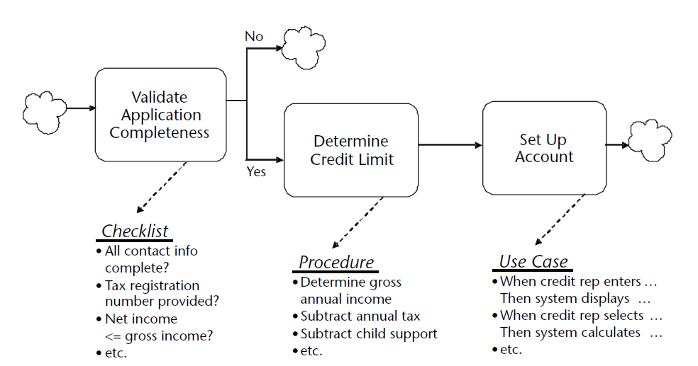
Task Level Diagram

Slide 83
Let’s Draw A Swimlane Diagram

Slide 84
Goals
Describe important characteristics of the to-be process
Examine as-is diagrams, and look at each enabler
Workflow design, IT motivation, measurement, etc
Specifications for new process
Develop swimlane diagrams at increasing levels of detail
Requires Innovative Ideas
Refer to Chapter 13 for some
best practices and ideas

Slide 85
Next steps
Take new process for a road test
What is working? What isn’t?
Gap analysis
Find barriers to adoption

Slide 86
Thanks to …
I would like to thank the following individuals with their help in creating this slide deck:
Sudip Bhattacharjee, Brian Steckelberg, Jeff Howey, Sinikka Waugh, Pam Mohr, Jodi Rhone, John Durman

